Slide 1
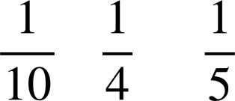
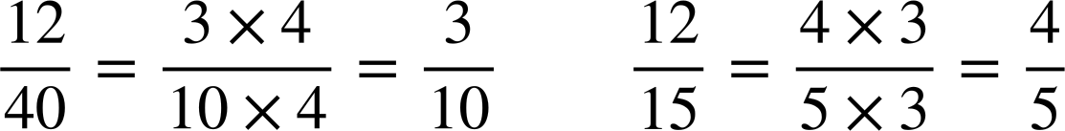
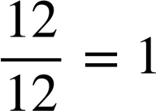
Checking understanding of multiplicative relationships
Task A: Comparing using proportion
1) By subdividing the bar models, work out what £3 is as a proportion of the whole amount.
a)
b)
c)
£30
£3 | £3 | £3 | £3 | £3 | £3 | £3 | £3 | £3 | £3
£3 is of £30
£12
£3 | £3 | £3 | £3
£3 is of £12
£15
£3 | £3 | £3 | £3 | £3
£3 is of £15
2) By simplifying fractions, work out:
a) what proportion £12 is out of £40?
b) what proportion £12 is out of £15?
c) what proportion £12 is out of £12?

Slide 2
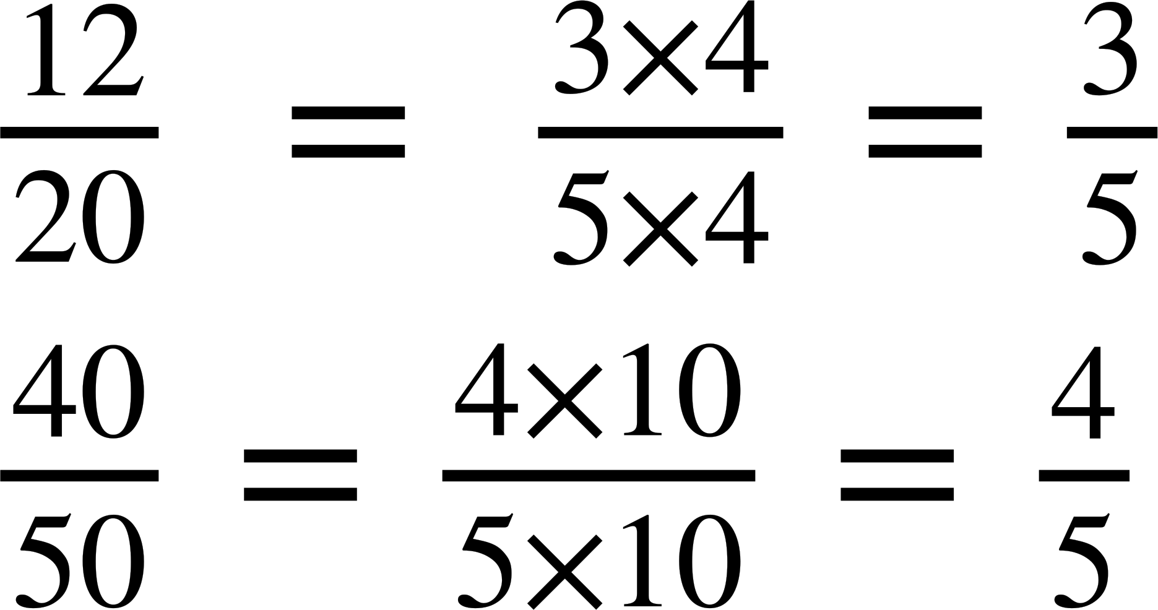

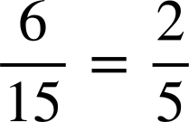
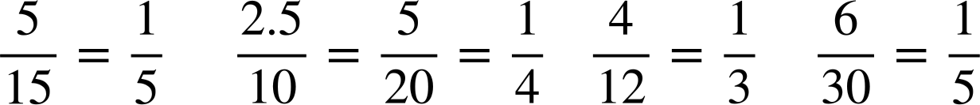
Checking understanding of multiplicative relationships
Task A: Comparing using proportion
3) Test A is out of 20. Laura gets 12 out of 20 correct.
Test B is out of 50. Sofia gets 40 out of 50.
Who got a higher proportion of answers correct?
Sofia got the highest proportion of answers correct.
Laura:
Sofia:
This represents the proportion Laura got correct.
This represents the proportion Sofia got correct.
4) Which pupil got the best allowance increase and why?
Which pupil got the best allowance increase and why?
Pupil | Normal allowance per month | Increase | Proportion of normal allowance
Aisha | £15 | £6
Andeep | £10 | £2.50
Izzy | £12 | £4
Jacob | £30 | £6
Aisha got the best allowance increase.
‹#›

Slide 3
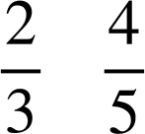
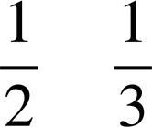
Checking understanding of multiplicative relationships
Task B: Paying attention to the whole
Insert the correct inequality =, < or > for the following:
50% of 900 > 10% of 4000
>
of 24 < of 60
d) <
e) of 30 < of 50
f) 1% of 900 = 900% of 1
2) Each pupil in Oak academy has a cashless account.
All Oak pupils have been excellent and the Oak teacher can award them with either 20% more of what is in their account or £2 more what is in their account.
Which offer should each pupil receive to get the best deal?
Pupil | Account
Andeep | £4.50
Aisha | £11.29
Izzy | £9.96
Jacob | £8.90
Jun | £10
Pupil | Account
Lucas | £32
Sam | £8.23
Alex | £2.13
Sofia | £20.12
Laura | £9.99
Anything over £10 should go for the 20% offer. Jun can have either.
‹#›

Slide 4



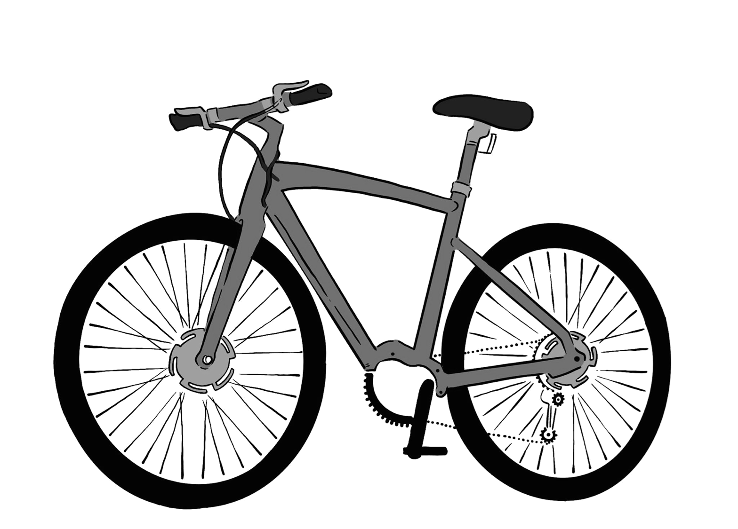
Checking understanding of multiplicative relationships
Task B: Paying attention to the whole
3) Tick which is the best offer or if there is not enough information.
Statement | A is better | B is better | Both the same | Not enough information
A is offered 10% of £100 B is offered 5% of £200
A is offered 79% B is offered 100%
A is offered of £24 B is offered of £19
A is offered 20% more money than B
4) Jacob is looking for a new bike. Two shops sell the same bike.
Shop B
Shop A
£120
£120
SALE 30% off
SALE 20% off
Plus an extra 10% off the sale price
30% of £120 is £36
So the cost of the bike in shop B is:
£120 − £36 = £84
20% of £120 is £24
So the sale price was
£120 − £24 = £96
Now we take 10% off the sale price:
10% of £96 is £9.60
So, in shop A the bike costs:
£96 − £9.60 = £86.40
Jacob is not correct. The cost in Shop B is £84 and in Shop A it is £86.40. Taking 20% then 10% is not the same as taking 30% of the same amount.
Jacob says, “Both have 30% off in total so the bike costs the same in both shops.” Show if Jacob is correct or not.
Mathematics in Education and Industry
v2.2

